Slide 1
THE SCIENCE OF SIN AND SALVATION
ROBERT MELASHENKO MD
Copyright Robert Melashenko 2013
All Rights Reserved

Slide 2
LECTURE FOUR
Another Look at “Sin” - Part II: THE BIOME

Slide 3
REVIEW
SIN = THE UNAUTHORIZED CHANGING OF GOD’S INFORMATION (GENOME FOR LIVING CELLS) BY EITHER DELETING OR ADDING TO THE CODE.

Slide 4
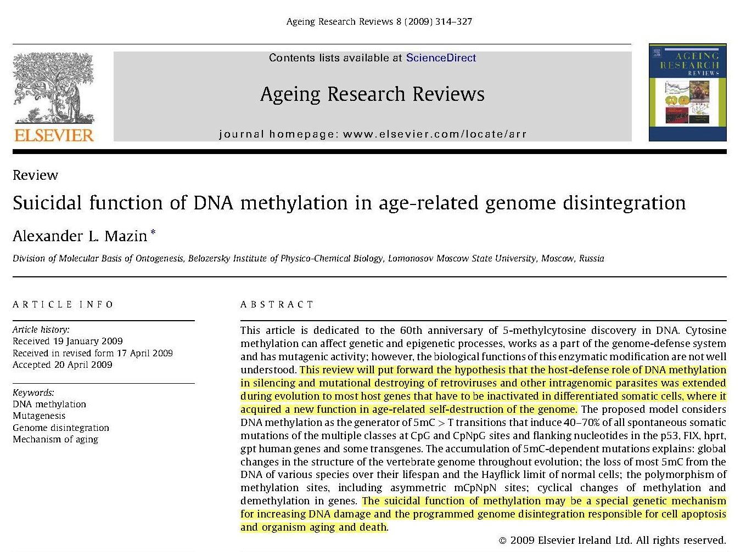
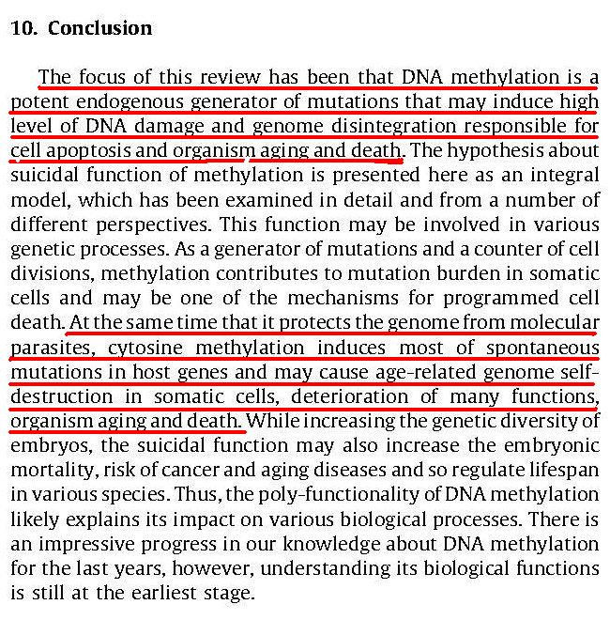

Slide 5
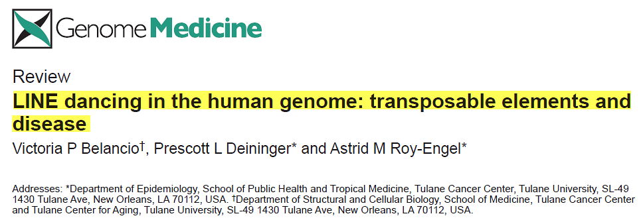
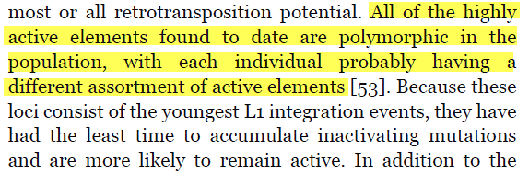
Belancio et al.: Genome Medicine 2009, 1:97

Slide 6
BIOME:
A biome is a specific environment that's home to living things suited for that place and climate.

Slide 7
For the earnest expectation of the creature waits for the manifestation of the sons of God.
For the creature was made subject to vanity (perverseness, depravity, fragility), not willingly, but by reason of him who has subjected the same in hope,
Because the creature itself also shall be delivered from the bondage of corruption into the glorious liberty of the children of God.
For we know that the whole creation groans and travails in pain together until now.
And not only they, but ourselves also, which have the first fruits of the Spirit, even we ourselves groan within ourselves, waiting for the adoption, to wit, the redemption of our body.
(Romans 8:19-23 AKJV)

Slide 8
Infestation--The Magnitude of the Problem.

Slide 9
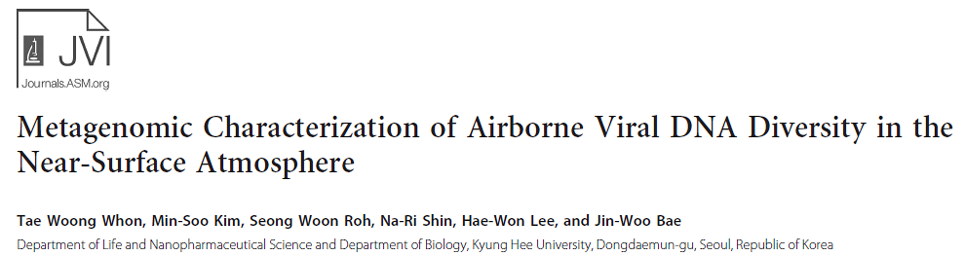
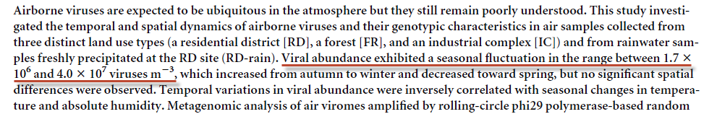
(1,700,000 – 40,000,000)
Journal of Virology August 2012 Volume 86 Number 15

Slide 10
Ocean

Slide 11
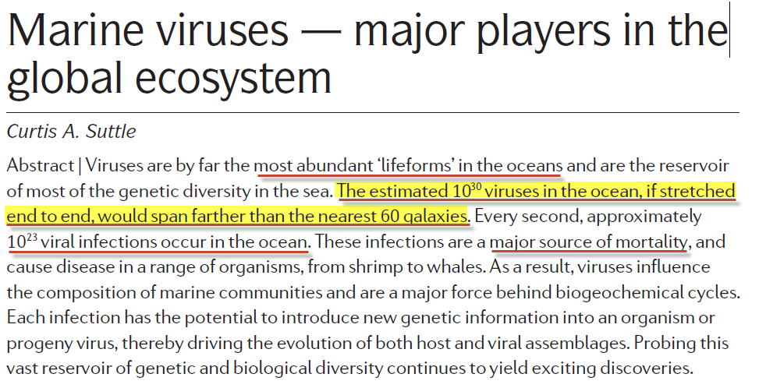
NATURE REVIEWS | MICROBIOLOGY VOLUME 5 | OCTOBER 2007

Slide 12
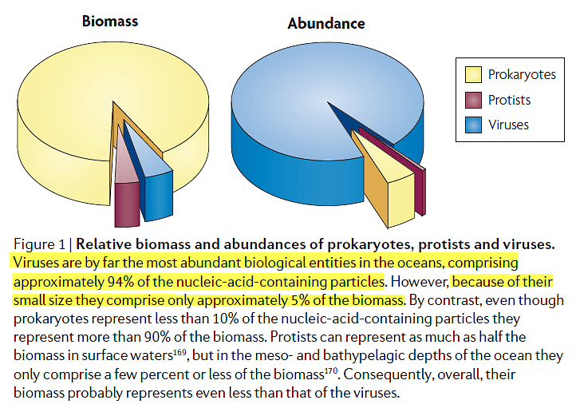
NATURE REVIEWS | MICROBIOLOGY VOLUME 5 | OCTOBER 2007

Slide 13
Plants and Animals

Slide 14
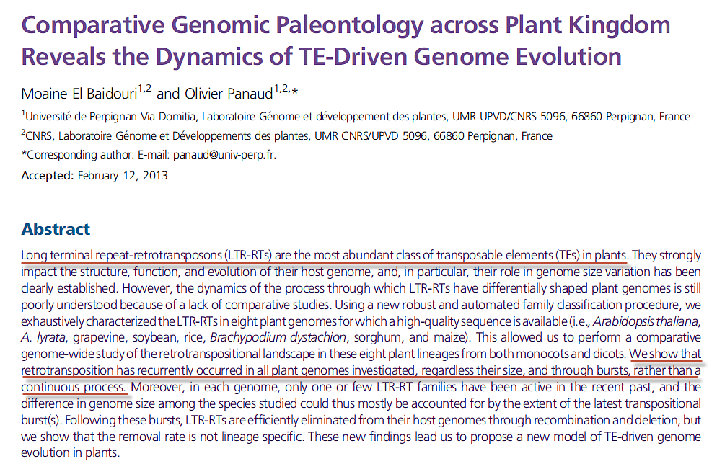
Genome Biol. Evol. 5(5):954–965 February 20, 2013

Slide 15

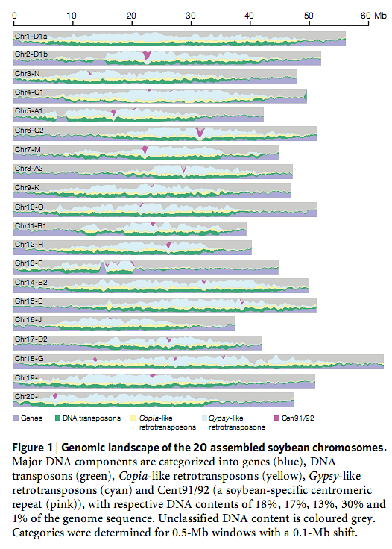

Slide 16
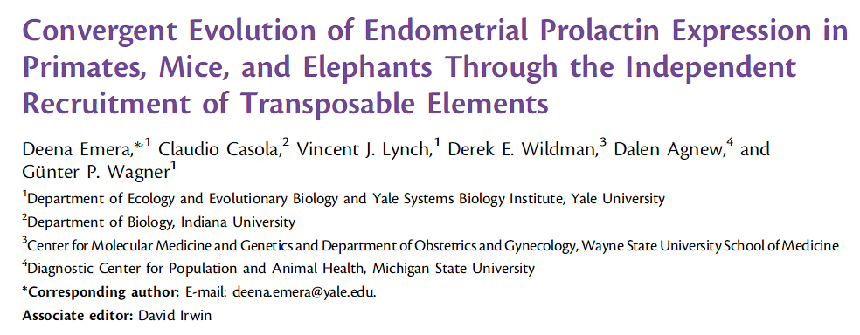
Mol. Biol. Evol. 29(1):239–247. 2012

Slide 17
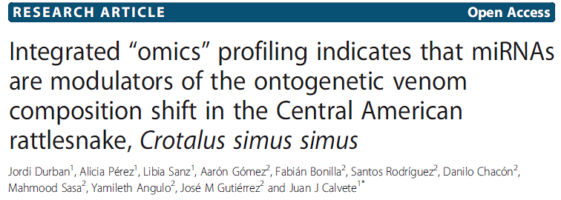
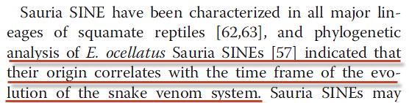
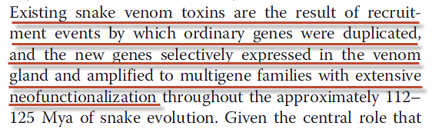
Durban et al. BMC Genomics 2013, 14:234

Slide 18
Bacteria

Slide 19

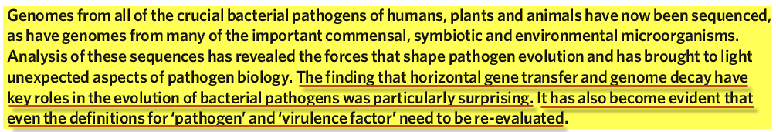

Slide 20
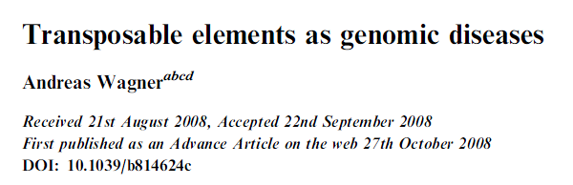
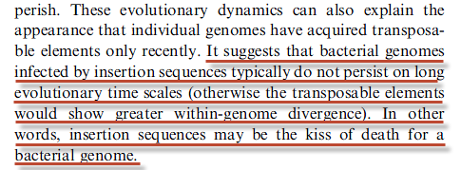
“The Kiss of Death”
Mol. BioSyst., 2009, 5, 32–35 | 33

Slide 21
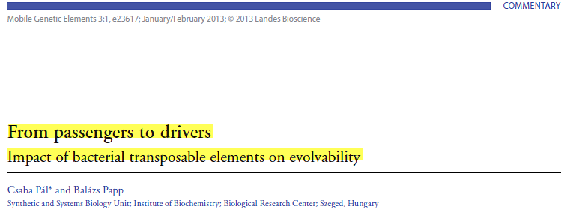
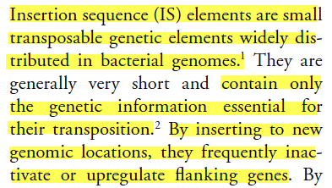

Slide 22
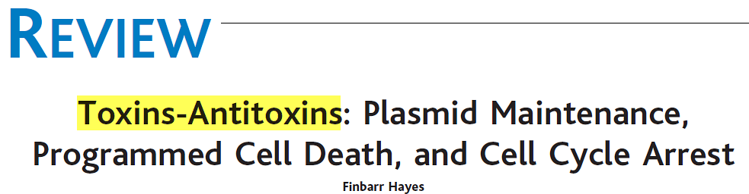
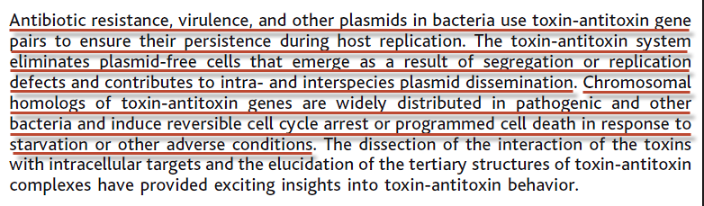
12 SEPTEMBER 2003 VOL 301 SCIENCE

Slide 23
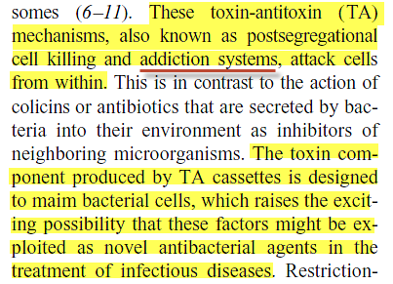
12 SEPTEMBER 2003 VOL 301 SCIENCE

Slide 24

Antimicrobial Agents and Chemotherapy April 2013 Volume 57 Number 4

Slide 25
Horizontal Information Transfer

Slide 26
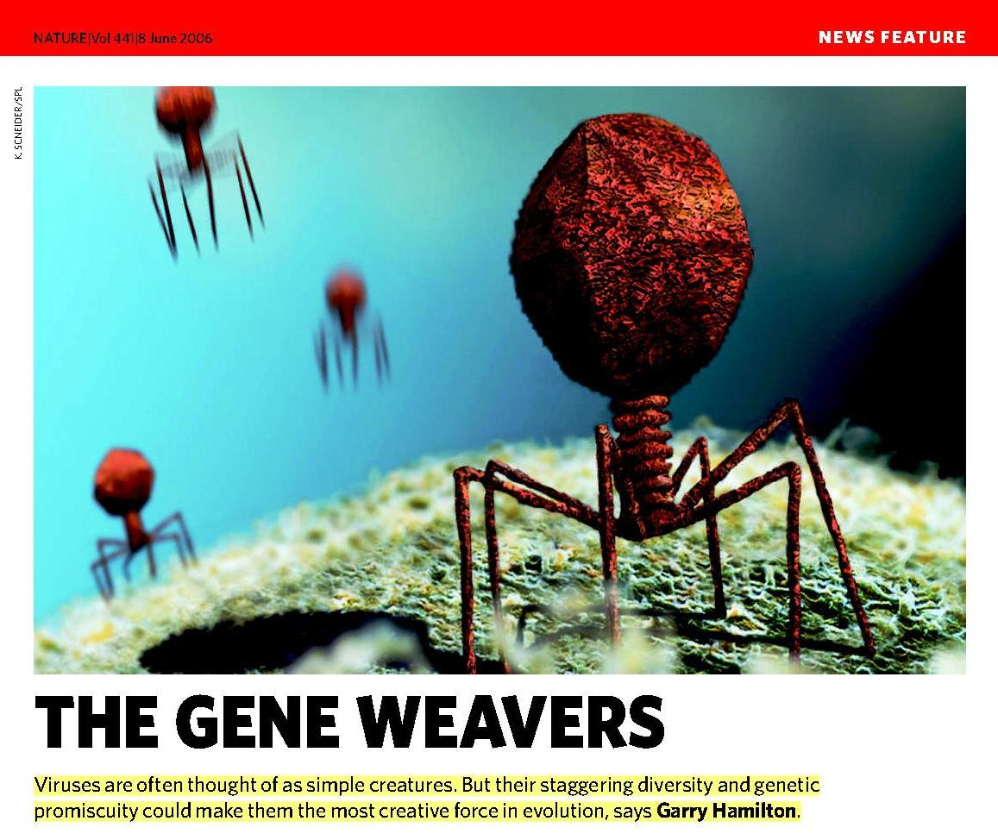

Slide 27
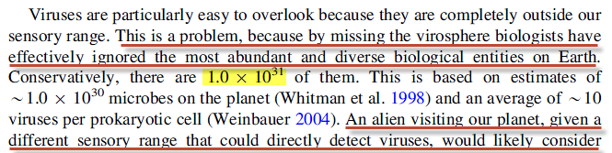
Viral Information Welcome to the viral world
Biol Philos (2013) 28:283–297

Slide 28
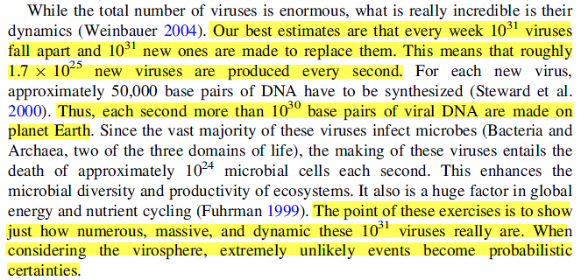
Viral Information
Biol Philos (2013) 28:283–297

Slide 29
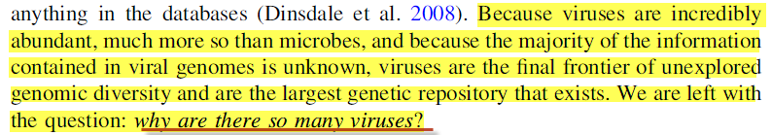
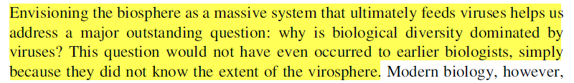
Conclusion

Slide 30
Recap: Mobile Genetic Elements in the Biome
Transposable Elements — Vertical transmission
Viruses—Horizontal transmission
Plasmids—Both horizontal and vertical transmission in bacteria

Slide 31
Yeast & Alcohol

Slide 32
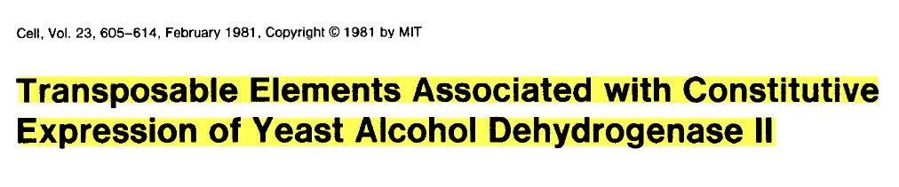
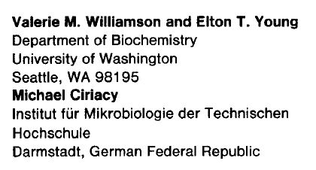

Slide 33
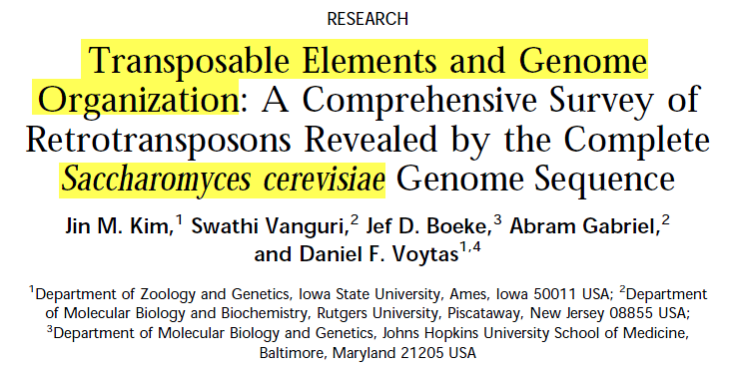
GENOME RESEARCH 8:464–478 ©1998

Slide 34
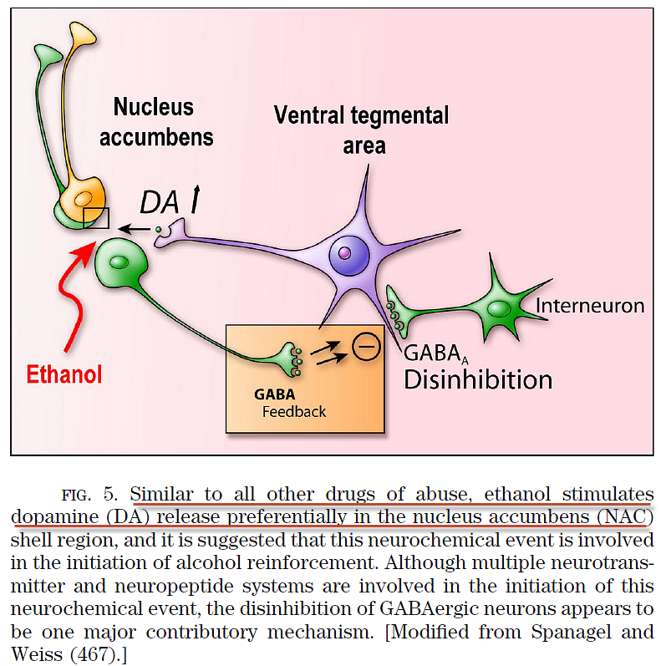
Physiol Rev • VOL 89 • APRIL 2009

Slide 35
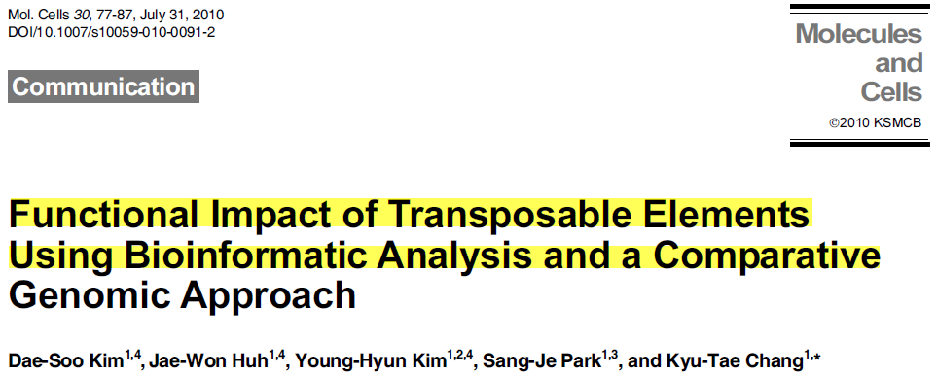
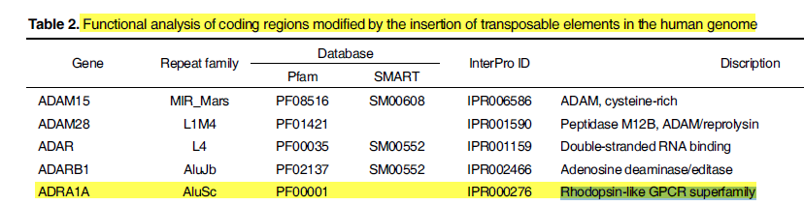

Slide 36
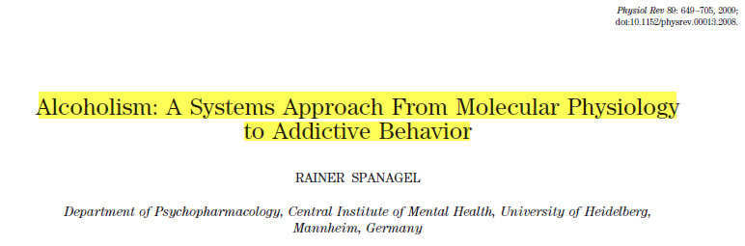
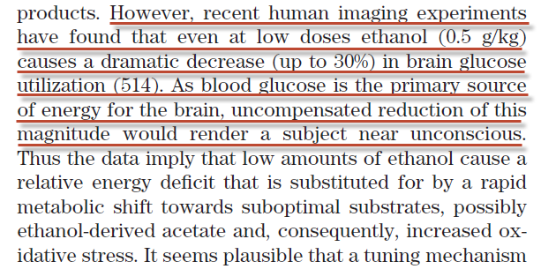

Slide 37
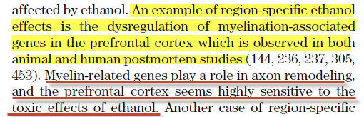
Physiol Rev • VOL 89 • APRIL 2009

Slide 38
Leprosy
Biblical Symbol of Sin

Slide 39
Leprosy (Hansen’s Disease) - Biblical analogy of sin
True Leprosy was incurable in Biblical times.
It spreads by droplets. (Contagious)
It physically deforms its victims.
It spreads throughout the whole body.
It attacks the sheath of nerve cells gradually causing inflammation then death of the nerve.
It isolates its victims as outcasts.
It affects the optic nerve, causing visual deficits and ultimately blindness.

Slide 40
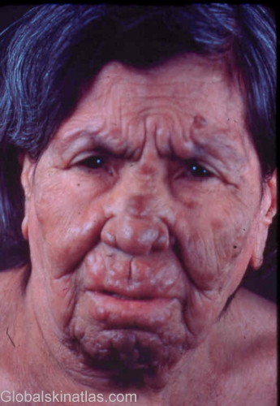
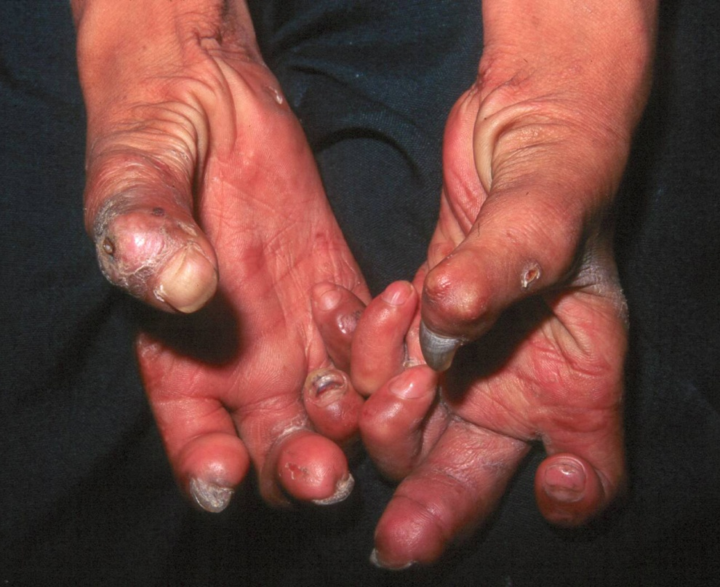
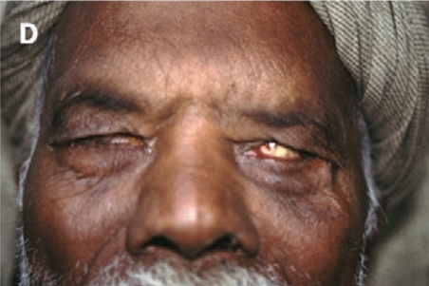
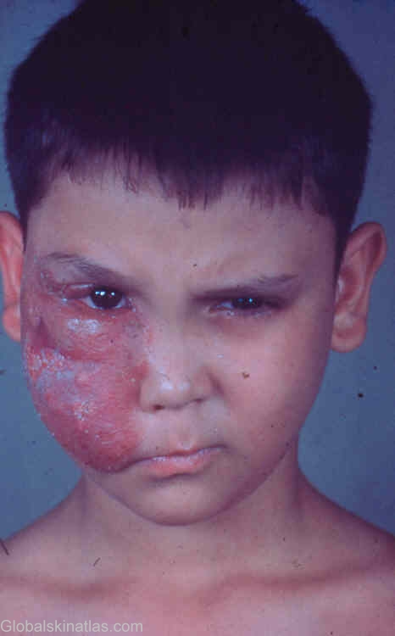
Why do you keep on rebelling? Do you want to be punished even more? Israel, your head is already covered with wounds, and your heart and mind are sick. From head to foot there is not a healthy spot on your body. You are covered with bruises and sores and open wounds. Your wounds have not been cleaned or bandaged. No medicine has been put on them. Isaiah 1:5-6 GNB

Slide 41

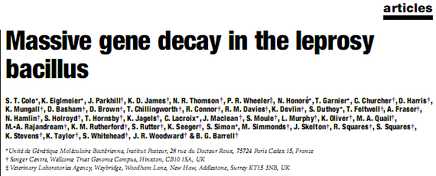
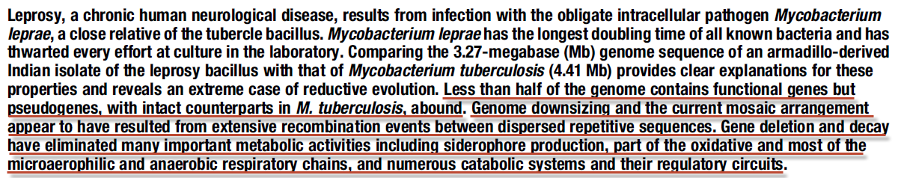
M. leprae genome sequenced 2001
Nature Vol. 409 22 February 2001, p.1007-1012

Slide 42
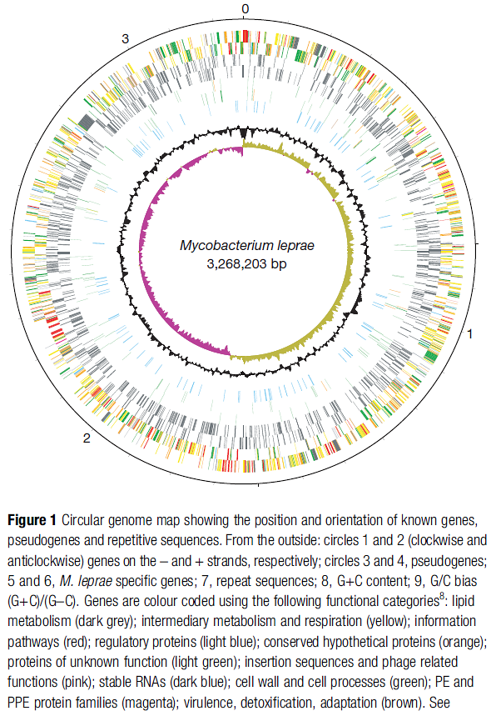
Nature Vol. 409 22 February 2001

Slide 43
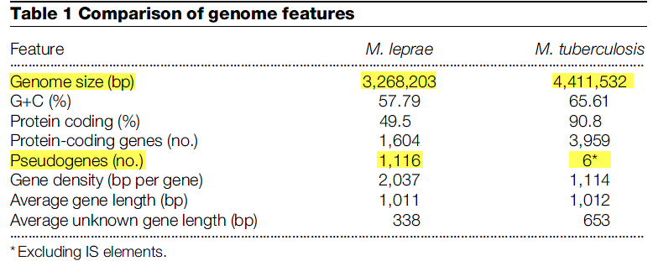
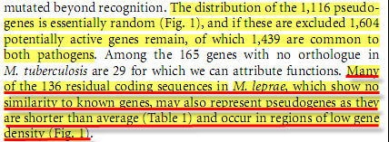
Nature Vol. 409 22 February 2001, p.1007-1012

Slide 44
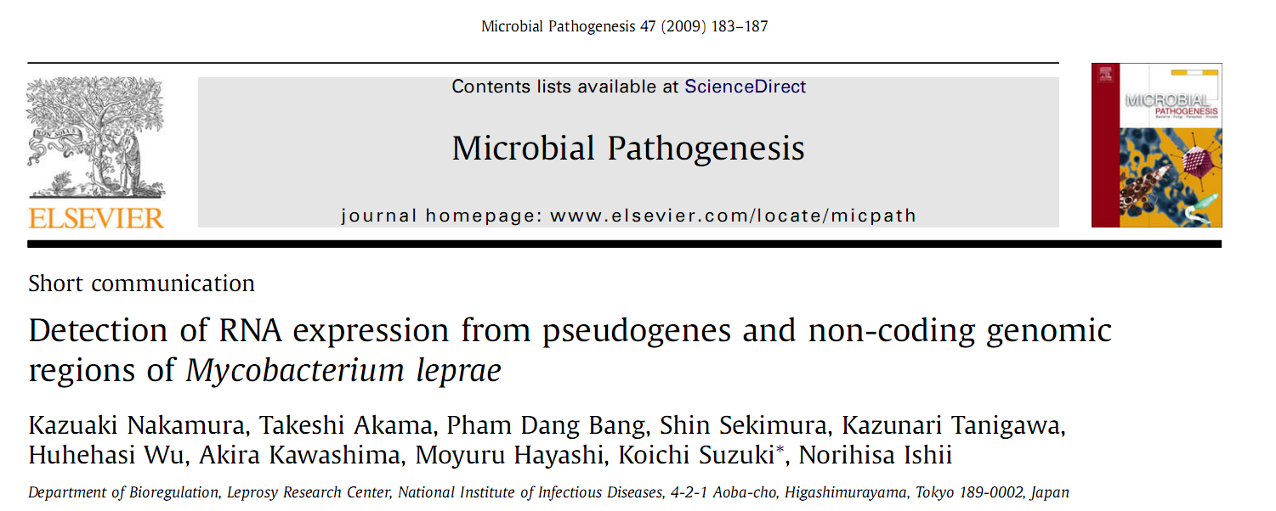
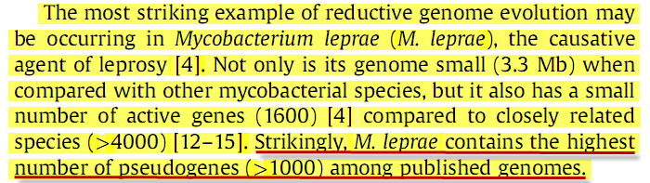
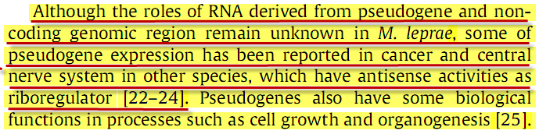

Slide 45
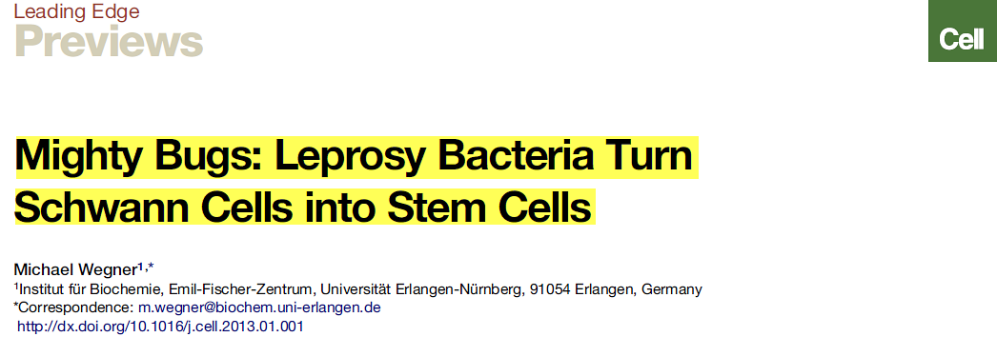
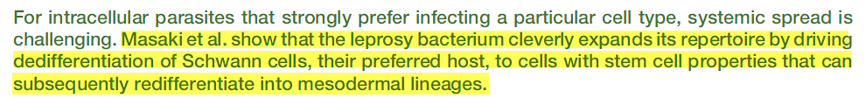

Cell 152, January 17, 2013

Slide 46
And it happened, as He was in a certain city, behold, a man full of leprosy! And seeing Jesus, he fell on his face and begged Him, saying, Lord, if You will, You can cleanse me. And stretching out the hand, He touched him, saying, I will! Be clean! And immediately the leprosy departed from him.
(Luke 5:12-13)

Slide 47
And He sitting on the throne said, Behold, I make all things new. And He said to me, Write, for these words are true and faithful.
(Rev 21:5)

